Slide 1
Donna North TSTEM Academy WBL and Participation Data

Slide 2
March 3, 2023 DNHS T-STEM academy visits nasa space center in Houston, tx.

Slide 3
March 3, 2023 DNHS T-STEM academy visits nasa space center in Houston, tx.

Slide 4
T-sTEM students in health sciences visit texas a&M higher education center at mcallen, tx.

Slide 5
T-stem students volunteer in a community food drive sponsored by hidalgo county precinct 1 and the food bank rgv

Slide 6
November 28, 2022 9:30 AM

Slide 7
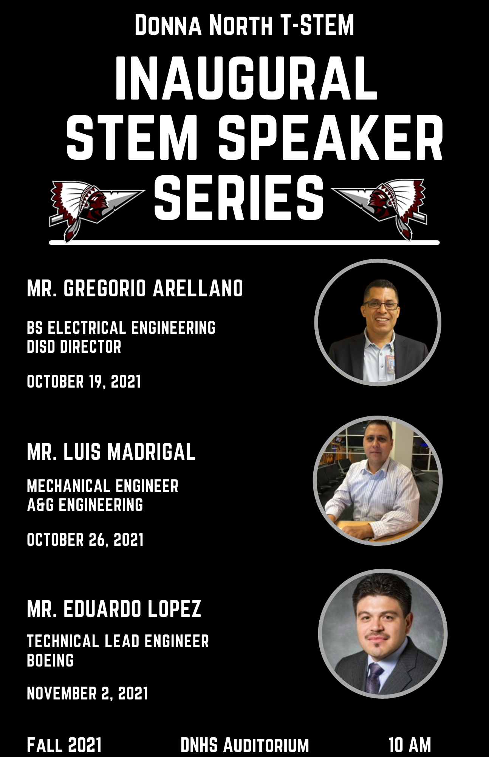
Fall 2021 Event Guest Speaker Series
Guest Speaker Series
During the month of October 2021, Donna North High School T-STEM Academy hosted a guest speaker series for the T-STEM Academy students. We partnered with local professionals in the STEM fields to have them come visit our campus and speak to our students. The speakers included Mr. Gregorio Arellano, BS Electrical Engineering (Donna ISD); Mr. Luis Madrigal, Mechanical Engineer (A&G Engineering); and Mr. Eduardo Lopez, Technical Lead Engineer (Boeing). These speakers shared their industry experiences first hand with our students. While each speaker had his own story to tell the overall message was that anything can be achieved through perseverance, hard work, and dedication.
Our ninth and tenth grade students attended the October 19th presentation by Mr. Gregorio Arellano.
Our eleventh grade students attended the October 26th presentation by Mr. Luis Madrigal.
Our twelfth grade students attended the November 2nd presentation by Mr. Eduardo Lopez.

Slide 8
Spring Event Space X Site Visit
Space X Site Tour
On December 3, 2021, Donna North High School T-STEM Academy partnered with Space X. The Academy took 45 students to tour their Brownsville, Texas facility. Students were able to tour the site, see first-hand how space ships are built, and see some of the latest welding technology in use. Students also had the opportunity to network with managers, recruiters, and welders at Space X to gain insight knowledge to one of today’s most technologically advanced and cutting edge companies.
40 students from both the eleventh and twelfth grades attended the Space X site visit.

Slide 9
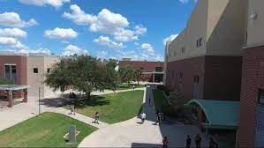
South Texas College (STC) Tour Visit
South Texas College (STC) Campus Visit
9th and 10th grade T-STEM students are projected to tour the South Texas College campus in McAllen, Texas - March 2022.

Slide 10
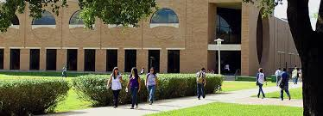
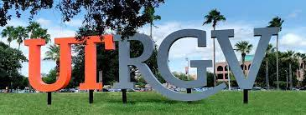
University of Texas Rio grande valley (UTRGV)visit
11th grade T-STEM students are projected to tour the University of Texas Rio Grande Valley in Edinburg, Texas - April 2022.

Slide 11
Texas a&m university - Kingsville visit
12th grade T-STEM students are projected to tour Texas A&M University Kingsville - April 2022.

